Slide 1
Behavioural & Experimental Economics Intertemporal choice Part 2
Adrien Fillon
University of Cyprus

Slide 2
Course Outline
Choice under Certainty
Judgement under Risk & Uncertainty
Choices under Risk & Uncertainty
Intertemporal Choice
The discounted utility model
Biases in intertemporal choice
Strategic Interaction

Slide 3
Preferences over Profiles
Some people also like to distribute pleasant and unpleasant events over time. If so, they are said to exhibit a preference for spread.
People might also have preferences over shapes of utility profiles. They might prefer increasing profiles, and/or like to end on a high note.

Slide 4
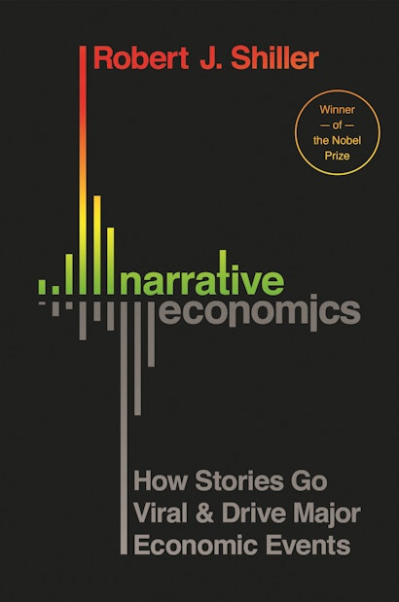
Narrative Life
People have a need for coherence
“Are human constructs that are mixtures of fact, emotion, human interest, and other extraneous details that form an impression on the human mind.”
Narratives are contagious: they spread like viruses from one person to another, sometimes quickly and far.
The idea to use tools from epidemiology to study economics

Slide 5
The Peak–End Rule
The peak–end rule represents one way to evaluate the desirability of utility streams or “episodes”.
Here, individuals care about the peak and the end of the utility stream, as opposed to the discounted utility.

Slide 6
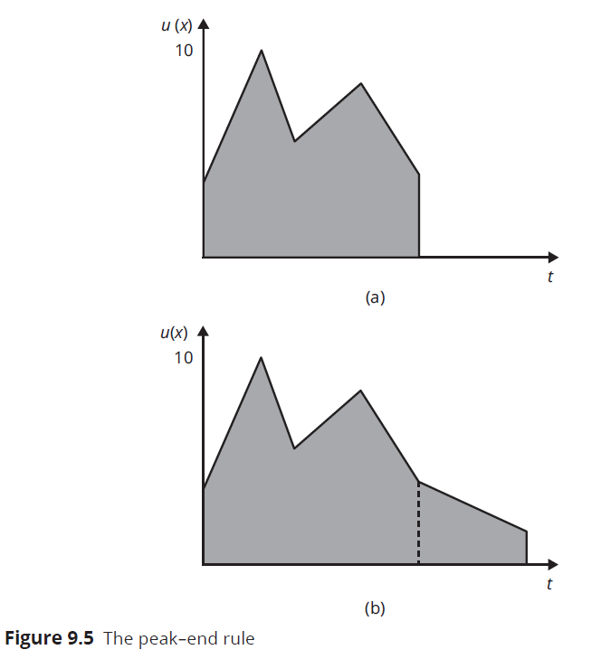
The Peak–End Rule
Notes:
Utility in Y, time in X,
Peak end rule – A > B
However, B has more utility (the area is higher) -> duration neglect
The lenght of the episode is not important

Slide 7
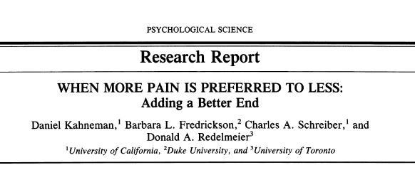
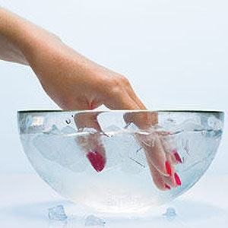
32 University of California Students
10$ - 1 hour
7L water 14 °C
Water temperature was controlled also by using another pump to circulate water through a coil submerged in room-temperature water (21 °C ± 1.1 °C). By simultaneously turn- ing off the first pump and turning on the second, the water temperature in the subject's tub could be increased by 1.1 °C (±0.3 °C) in 30 s.

Slide 8
An on-line measure of discomfort was obtained using a "discomfort meter," which consisted of a potentiometer and a linear array of 15 light-emitting diodes (LEDs). A single green LED at one end of the display remained lit at all times. By adjusting the potentiometer, subjects could control the number of red LEDs that were lit, thereby indicating the level of discomfort

Slide 9
5s cold temperature water to « test »
2 trials for 2minutes
They immersed one hand in water at the moderately painful temperature of 14 °C for 60 s and a longer trial in which they immersed the other hand in water at 14 °C for 60 s, then kept the hand immersed 30 s longer while the temperature of the water was raised slightly, still within the uncomfortable

Slide 10
Now what trial did the participant chose for the third trial, the longer or the shorter ?
22 out of the 32 participants chose the longer, no matter if it was experienced first or second, or with the dominant or non-dominant hand. The only reason is the decrease in discomfort at the end.

Slide 11
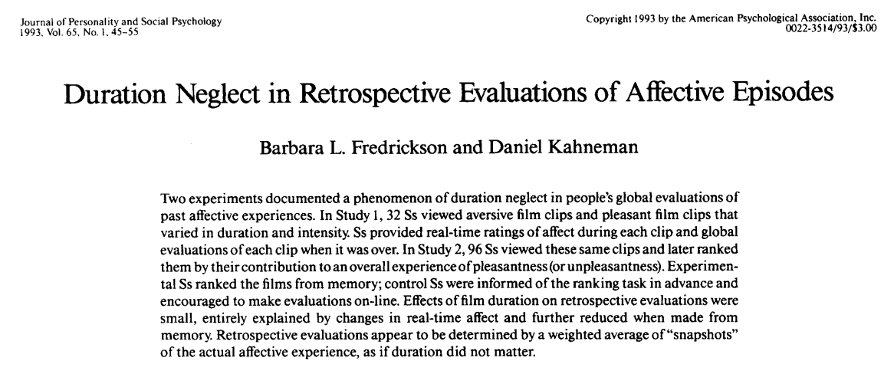
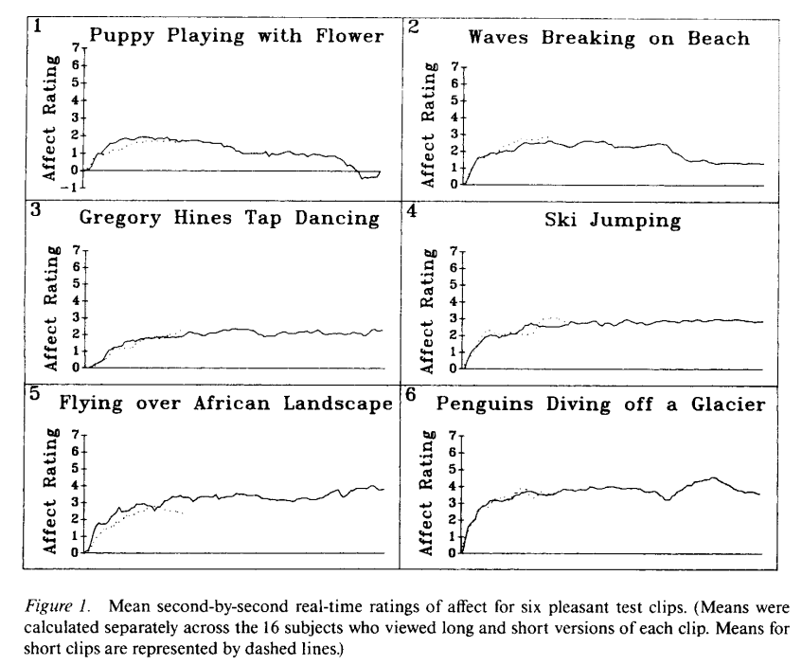
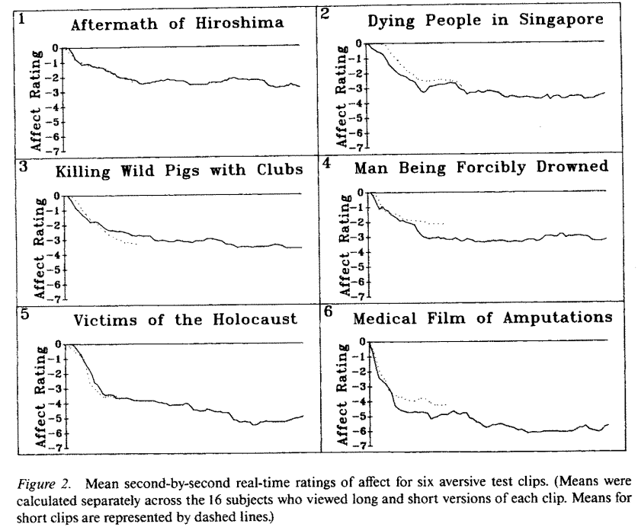

Slide 12
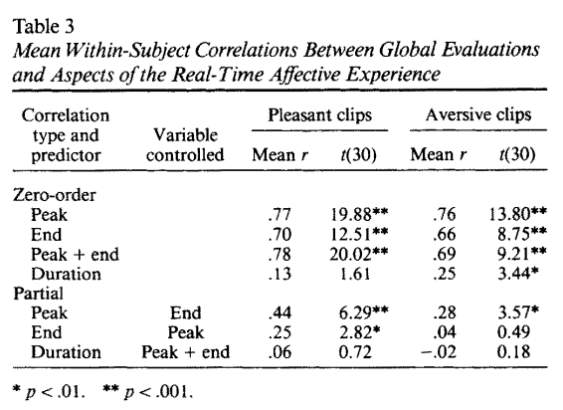

Slide 13
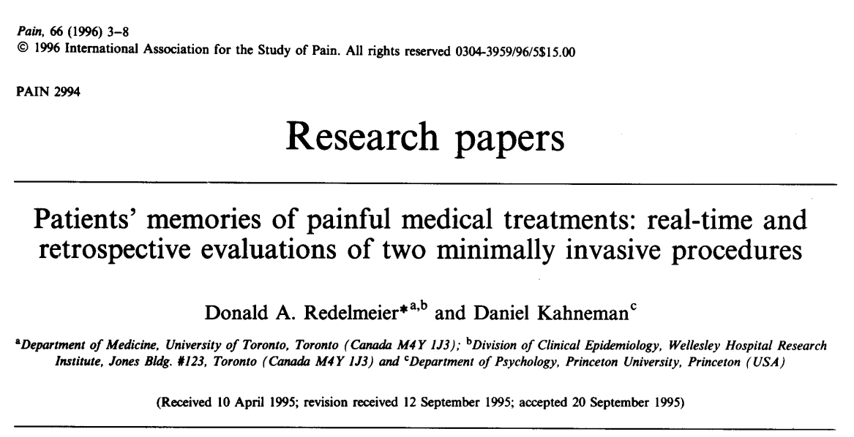

The first study involved patients undergoing colonoscopy (n= 154) and the second study involved patients undergoing lithotripsy (n= 133).
These two procedures were selected because they provided unambiguous starting and ending points. The colonoscopy procedure was defined as the interval between insertion and removal of the colonoscope, and the Iithotpsy procedure was defined as the interval between the first and last shock.

Slide 14
A hand-held device was used to control the position of a marker displayed on a computer screen. The computer screen presented a 19-cm visual analogue scale, with ends denoted as ‘no pain’ and ‘extreme pain’ and prompted the patient every 60 sec to ‘rate the current intensity of pain’. The position of the marker was then converted into a score that ranged between O and 10, where higher numbers indicated more severe pain.
Patients provided retrospective evaluations within an hour after the procedure by judging the ‘total amount of pain experienced’. They used a 10-point rating scale with ends denoted as ‘no discomfort’ and ‘awful discomfort’.

Slide 15
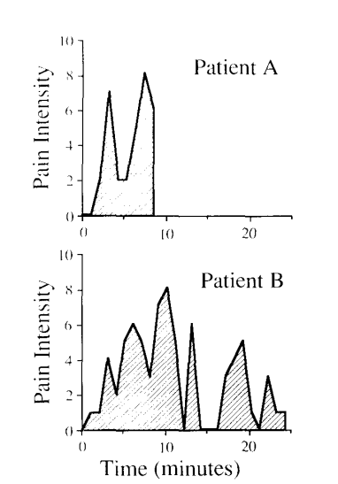

Slide 16
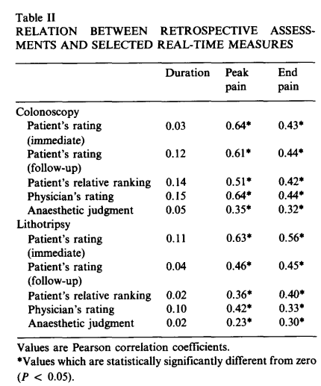
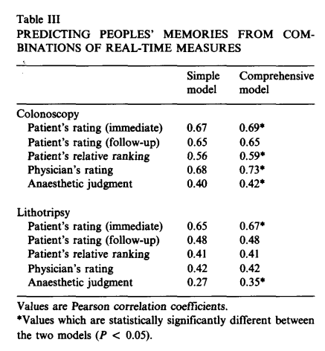
Notes:
No relation between retrospective assessment and duration : duration neglect
The simple model included only Peak Pain and End Pain as predictors. The comprehensive model included four additional predictors: Total Pain, Average Pain, Initial Pain, and Duration. The improvement in accuracy obtained by including the additional variables was small, and in several cases not statistically significant (Table III). In no case was the marginal improvement in accuracy related to measurement of Total Pain

Slide 17
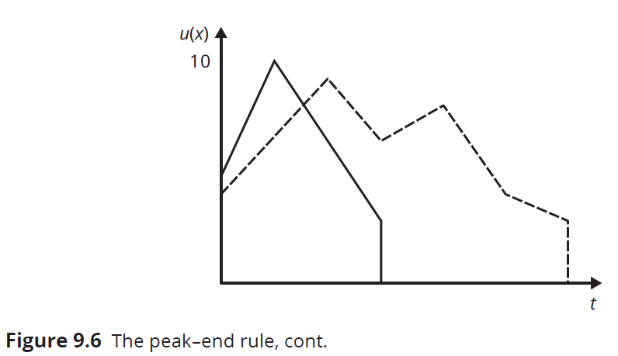
Example
Would a person who follows the peak–end rule choose the solid line or the dashed line episode?
Notes:
Given that the episode represented by a solid line has higher peak utility than the
episode represented by a dashed line, and that the two have the same end utility, the person would
favor the former over the latter.

Slide 18
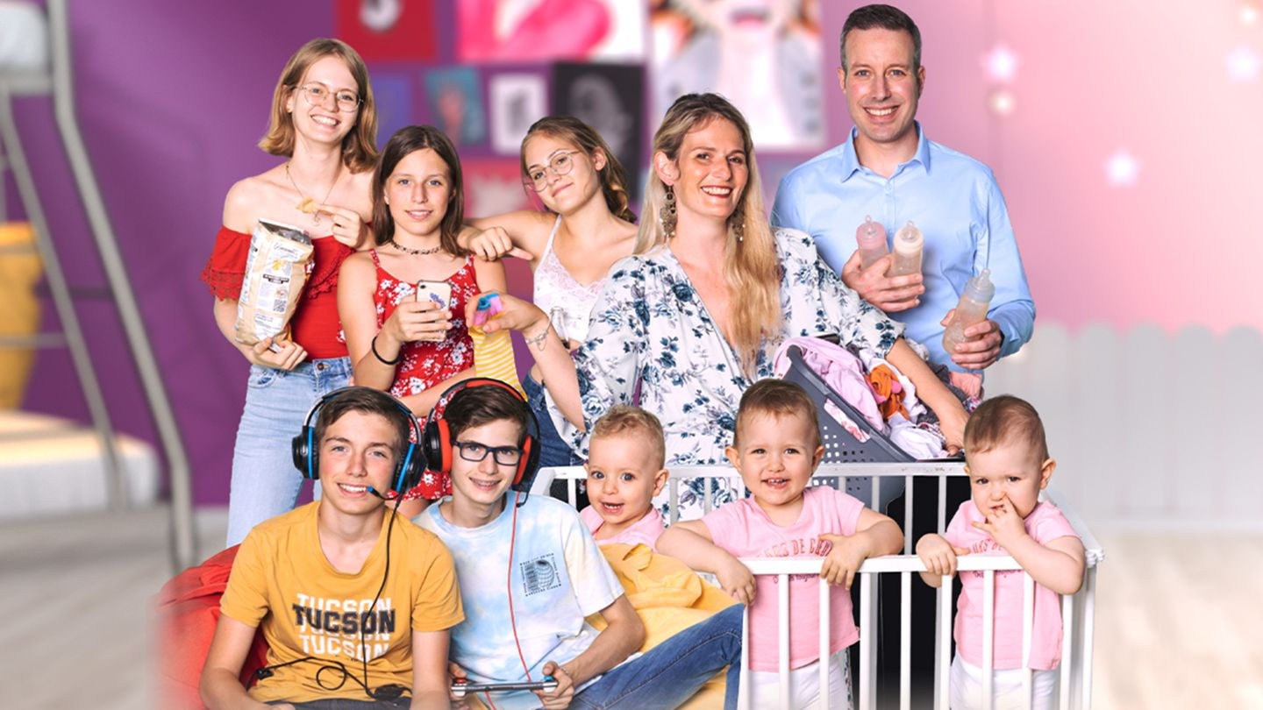
Notes:
The peak–end rule can perhaps explain why people keep having children,
even though systematic data suggest that parents are on the average less
happy than non-parents, and that parents on the average are less happy
when taking care of their children than when they are engaged in many
other activities. As long as the most intense joy generated by children
exceeds the most intense joy from other sources, and holding end
experience constant, people will rank having children above other
experiences. Duration neglect entails that long sleepless nights and the like
will be relatively unimportant in the final analysis.

Slide 19
Misprediction and miswanting
Underprediction of adaptation
In one study, participants who did not currently have a branded coffee cup reported that, if they had one, they would be willing to sell it for between $3 and $4; once they were awarded one, they said they would need between $4 and $6 to give it up.
Notes:
When we go grocery shopping, we need to be mindful not only of the preferences we have when doing the shopping, but of the preferences that we will have when it is
time to prepare and eat the food.
When we choose a course of study, we have to consider the desires we will have while pursuing the degree, but also those we will have on the job for the rest of our careers. When we
deliberate about whether to form a family and have children, we cannot ignore the preferences we will have 20, 40, or 60 years hence. And if we are time inconsistent and sophisticated about it, we have to anticipate how our preferences will change over time
As it turns out, people are not very good at predicting their future preferences.

Slide 20
Misprediction and miswanting
Underprediction of adaptation
Diversification bias
When participants made separate choices on each of the three occasions, only 9 percent chose three different snacks. By contrast, when participants had to make all three choices during the first class meeting, 64 percent chose three different snacks. Such results suggest that people exaggerate the degree to which their future selves will favor variety and consequently diversify too much.
Notes:
When we go grocery shopping, we need to be mindful not only of the preferences we have when doing the shopping, but of the preferences that we will have when it is
time to prepare and eat the food.
When we choose a course of study, we have to consider the desires we will have while pursuing the degree, but also those we will have on the job for the rest of our careers. When we
deliberate about whether to form a family and have children, we cannot ignore the preferences we will have 20, 40, or 60 years hence. And if we are time inconsistent and sophisticated about it, we have to anticipate how our preferences will change over time
As it turns out, people are not very good at predicting their future preferences.

Slide 21
Misprediction and miswanting
Underprediction of adaptation
Diversification bias
Projection bias
People project their current preferences onto their future selves. when we are extremely hungry, we overestimate how much we will want to eat under more normal circumstances, and when we are extremely full, we underestimate it.
Notes:
When we go grocery shopping, we need to be mindful not only of the preferences we have when doing the shopping, but of the preferences that we will have when it is
time to prepare and eat the food.
When we choose a course of study, we have to consider the desires we will have while pursuing the degree, but also those we will have on the job for the rest of our careers. When we
deliberate about whether to form a family and have children, we cannot ignore the preferences we will have 20, 40, or 60 years hence. And if we are time inconsistent and sophisticated about it, we have to anticipate how our preferences will change over time
As it turns out, people are not very good at predicting their future preferences.

Slide 22
Misprediction and miswanting
Underprediction of adaptation
Diversification bias
Projection bias
Hot–cold empathy gaps
Our inability when in a “hot” emotional state to empathize with people (ourselves or others) when in a “cold” state, and vice versa. The result is that when we are in a hot state – whether we are experiencing hunger, thirst, anger, embarrassment, or sexual arousal – we tend to underestimate how different our preferences are when we are in a cold state, and the other way around.
Notes:
When we go grocery shopping, we need to be mindful not only of the preferences we have when doing the shopping, but of the preferences that we will have when it is
time to prepare and eat the food.
When we choose a course of study, we have to consider the desires we will have while pursuing the degree, but also those we will have on the job for the rest of our careers. When we
deliberate about whether to form a family and have children, we cannot ignore the preferences we will have 20, 40, or 60 years hence. And if we are time inconsistent and sophisticated about it, we have to anticipate how our preferences will change over time
As it turns out, people are not very good at predicting their future preferences.

Slide 23
Misprediction and miswanting
Underprediction of adaptation
Diversification bias
Projection bias
Hot–cold empathy gaps
Miswanting
Major source of miswanting is impact bias: the tendency to overestimate the enduring impact of future events on our emotional lives. While many of us imagine that winning a million dollars would make us lastingly happy and becoming disabled lastingly sad, a classic study argued the effects of lottery winnings and sudden disability are attenuated over time. Similarly, marriage, divorce, fame, and fortune have a much smaller effect on our emotional lives, including our happiness, than people tend to imagine.
Notes:
When we go grocery shopping, we need to be mindful not only of the preferences we have when doing the shopping, but of the preferences that we will have when it is
time to prepare and eat the food.
When we choose a course of study, we have to consider the desires we will have while pursuing the degree, but also those we will have on the job for the rest of our careers. When we
deliberate about whether to form a family and have children, we cannot ignore the preferences we will have 20, 40, or 60 years hence. And if we are time inconsistent and sophisticated about it, we have to anticipate how our preferences will change over time
As it turns out, people are not very good at predicting their future preferences.

Slide 24
Misprediction and miswanting
Underprediction of adaptation
Diversification bias
Projection bias
Hot–cold empathy gaps
Miswanting
Impact bias
Focusing illusion
The tendency for whatever you are attending to seem more important than it is. A person thinking about money, or a new car, or a bigger house, is likely to overestimate the emotional impact of getting more money, a new car, or a bigger house. But as Kahneman puts it: “Nothing in life is as important as you think it is when you are thinking about it.”
Notes:
When we go grocery shopping, we need to be mindful not only of the preferences we have when doing the shopping, but of the preferences that we will have when it is
time to prepare and eat the food.
When we choose a course of study, we have to consider the desires we will have while pursuing the degree, but also those we will have on the job for the rest of our careers. When we
deliberate about whether to form a family and have children, we cannot ignore the preferences we will have 20, 40, or 60 years hence. And if we are time inconsistent and sophisticated about it, we have to anticipate how our preferences will change over time
As it turns out, people are not very good at predicting their future preferences.

Slide 25
In estimating for practical purposes the value of different pleasures open to us, we commonly trust most to our prospective imagination: we project ourselves into the future, and imagine what a particular pleasure will amount to under hypothetical circumstances. This imagination seems to be chiefly determined by our experience of past pleasures… but partly also by the state of our mind or nerves at the time.
What kind of misprediction is described in the passage, by the nineteenth-century moral philosopher Henry Sidgwick?
Underprediction of adaptation
Diversification bias
Projection bias
Hot–cold empathy gaps
Miswanting
Impact bias
Focusing illusion
Notes:
Projection Bias

Slide 26
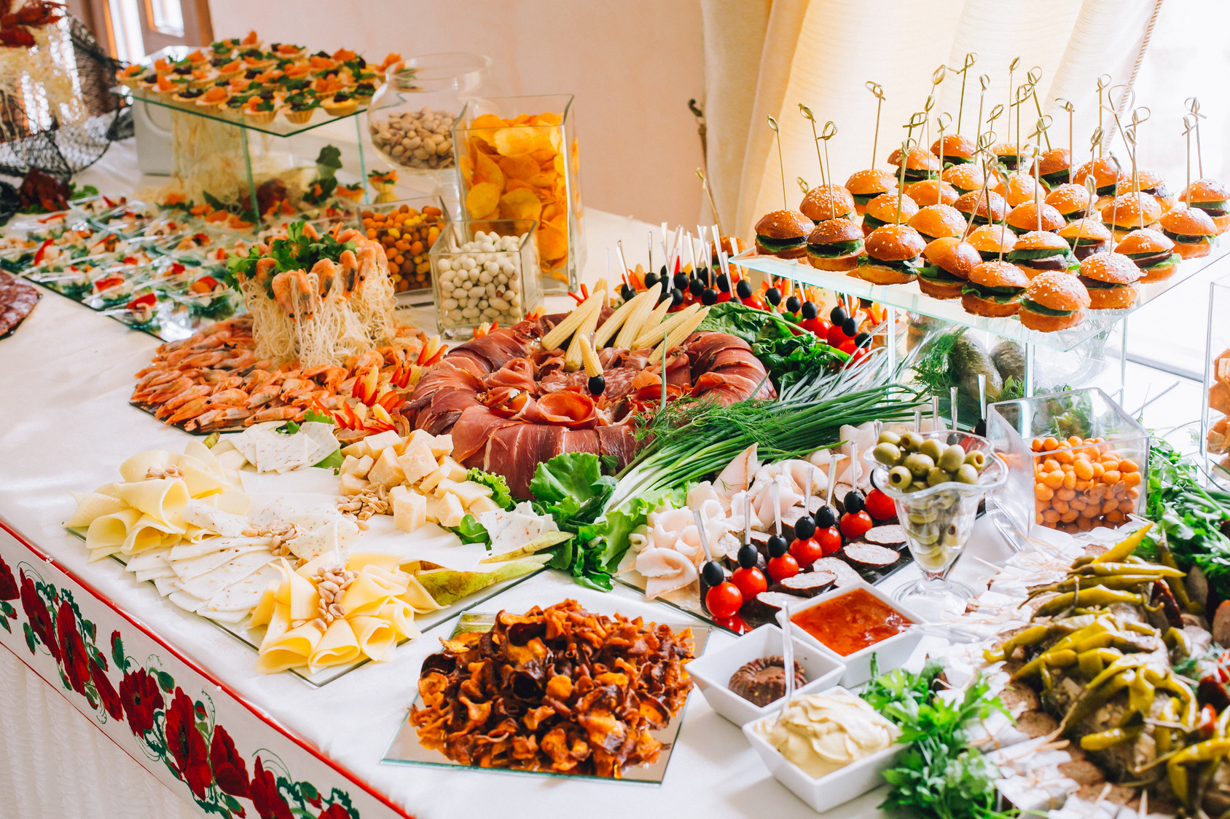
Notes:
Use the concepts of (a) diversification bias, (b) projection bias, and (c) hot–cold empathy gaps to explain how a person can choose food he or she will later have no interest in eating.

Slide 27
The phenomena discussed in this section make us strangers to ourselves, in that they may leave us shocked and surprised at the bizarre tastes of the person we thought we knew the best – namely, ourselves. To the extent that the right decision depends on accurate predictions, moreover, misprediction and miswanting can lead to bad decisions – even by our own lights.
If you want to avoid misprediction and miswanting, Sidgwick proposed keeping close tabs on your and others’ emotional reactions. He advocated what he called the empirical–reflective method:
[We] must substitute for the instinctive, implicit inference just described a more scientific process of reasoning: by deducing the probable degree of our future pleasure or pain under any circumstances from inductive generalizations based on a sufficient number of careful observations of our own and others’ experience.

Slide 28
Misprediction and miswanting
Underprediction of adaptation
Diversification bias
Projection bias
Hot–cold empathy gaps
Miswanting
Impact bias
Focusing illusion
Potential solution: Empirical–reflective method

Slide 29
Happiest profession
Gilbert, 2015
Notes:
1 Principa Security guard
2 Executive chef Merchandiser
3 Loan officer Salesperson
4 Automation engineer Dispatcher
5 Research assistant Clerk
Physical therapist
Firefighter
Teacher
Quality Assurance Analyst

Slide 30
Concept Recap
Preference for spread
Preference over profiles
Peak-end rule
Misprediction
Miswanting
Empirical-reflective method

